Slide 1
Unit 4 IMAGE RESTORATION
Presented By
Er.Harendra Bikram Shah
(Lecturer)
Department of Computer Engineering

Slide 2
OUTLINES
Introduction to Image Restoration
Noise Models Restoration in the Presence of Noise only Spatial Filtering
Periodic Noise Reduction by Frequency Domain Filtering

Slide 3
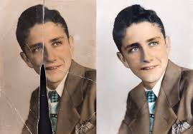
Introduction to Image Restoration
Image restoration refers to the process of enhancing or recovering the quality of a digital image that has been degraded or damaged.
The degradation of images can occur due to various factors such as noise, blurring, compression artifacts, or other distortions during acquisition, transmission, or storage.
The goal of image restoration is to improve the visual appearance of the image, making it closer to its original or desired state.

Slide 4
Introduction to Image Restoration
Common methods include:
Noise Reduction:
Deblurring:
Artifact Removal:
Resolution Enhancement:
Color Correction:
Image restoration is widely used in various fields,
medical imaging
satellite imagery
Surveillance
Photography
video processing

Slide 5
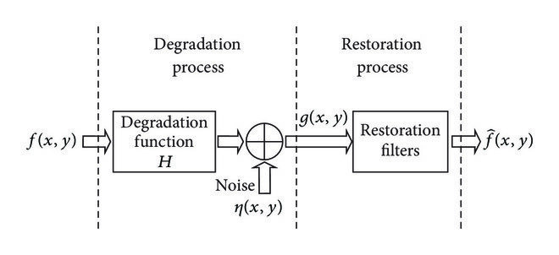
Image Degradation /Restoration Process

Slide 6
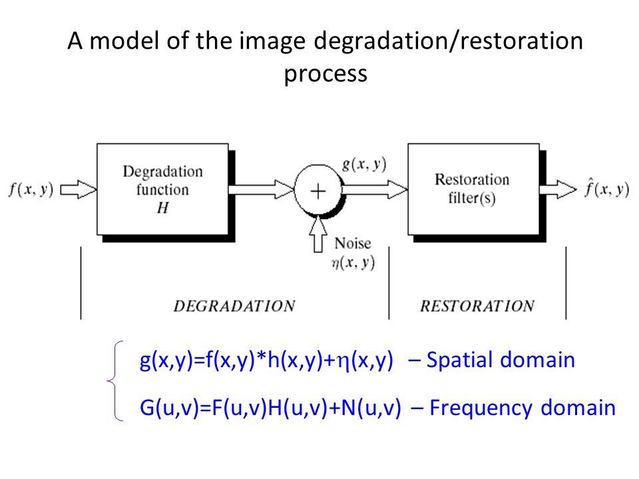

Slide 7
Noise Models Restoration in the Presence of Noise only Spatial Filtering
Spatial filtering involves manipulating the pixel values of an image based on their spatial arrangement.
In the context of noise reduction, spatial filters are designed to preserve image details while reducing the impact of noise.
process of noise reduction using spatial filtering:
Understanding Noise Models:
Spatial Filtering:
Mean Filter:
Median Filter:
Gaussian Filter:
Adaptive Filters:
Thresholding Techniques:

Slide 8
Periodic Noise Reduction by Frequency Domain Filtering
Transforming the image from the spatial domain to the frequency domain using techniques such as the Fourier Transform, applying filtering in the frequency domain, and then transforming the image back to the spatial domain.
steps for periodic noise reduction by frequency domain filtering:
Fourier Transform:
Frequency Spectrum Analysis:
Filter Design:
Filtering Operation:
Inverse Fourier Transform
Post-Processing

Slide 9
End of UNIT 4

Slide 10
THANK YOU

